Slide 1




Introduction
to
OTOM composite
Simulation software & Digital Twin
Composite and CFD simulations tools
Feb 2026
Borne, the Netherlands

Slide 2

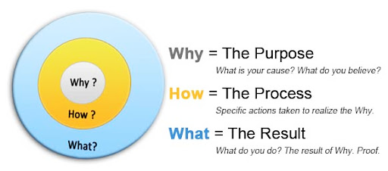
Agenda
Introduction, Who?
Benefits, Why OTOM?
Expertise, How?
Product, What?

Slide 3
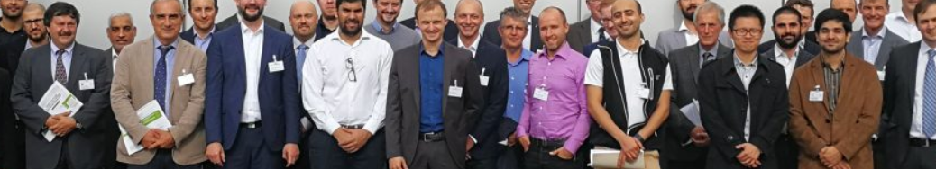






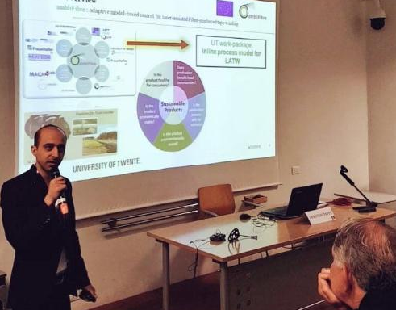
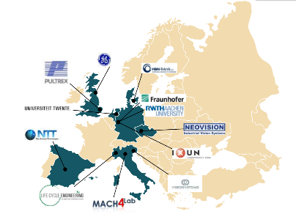
Introduction
First software design, implementation and validation within the project ambliFibre (H2020-EU)
Amin Zaami, Ph.D. In Mechanical Engineering
University of Twente,
Director at OTOMcomposite
Challenges: Review
Approach: Innovation
Result: Success
Predicting temperature distribution within laser-assisted composite production processes in real time (millisecond response)
Remote access to experiments for validations
Integration of model for inline monitoring
Discussion of production challenges with industrial partners
Creation and smart implementation of innovative algorithms
Designing new approaches and discuss proposed methods with partners
Strong collaborations with industrial project partners
Partners and project managers satisfaction
Real-time (inline) process predictions
Realizing in-process and offline optimizations
Defining new ways to further improve the technology
Dissemination in scientific conference and journal papers
Goal: adaptive model-based control for laser-assisted fiber-reinforced tape winding of composite pipes and vessels

Slide 4
State-of-the-art
Accurate temperature control is critical for defect-free FRP composite parts in automated fiber placement (AFP).
Current industry practices use thermal cameras with a feedback-loop controller, but limitations arise in critical areas requiring early compensation and through-thickness temperature or viscosity control.
Our physics-based tool serves as a key solution for precise process control and mastery.
Summary of issues: | Problems
Trial-error based method Non-efficient controller Lack of process knowledge Costly process | Temperature localization Process deviations Reliability issue Non-homogeneous quality High design engineering time
Target:
Minimize temperature variation
Better product crystallinity
Higher bond strength
Stable processing
Prevent smoke and degradation, squeeze out-of-flow
Decrease Production time
Decrease final cost

Slide 5
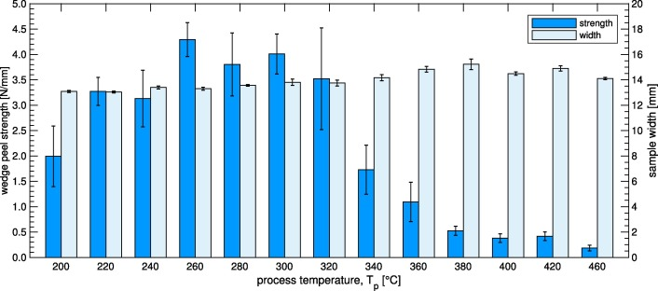
On critical curved locations?
(Quality: bonding strength)
Based on the mechanical tests:
The quality can be improved more than 3 times
Improving reliability (less variation of quality strength)
Cost and energy saving
Saving time
Highest possible quality
Obtained quality without controlling temperature at corners
Problem
Stokes-Griffin, C. M., et al. "The effect of processing temperature on wedge peel strength of CF/PA 6 laminates manufactured in a laser tape placement process." Composites Part A: Applied Science and Manufacturing 121 (2019): 84-91.
Notes:
Takes some seconds to power react and show its effects on the Nip-point

Slide 6
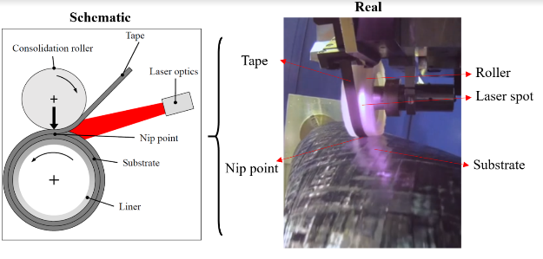

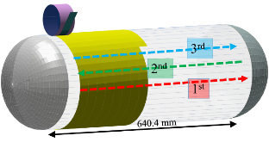
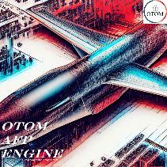
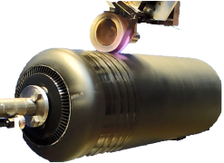

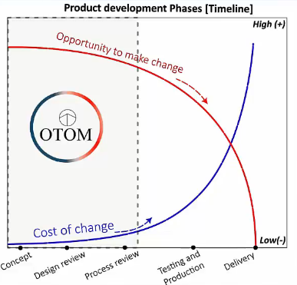
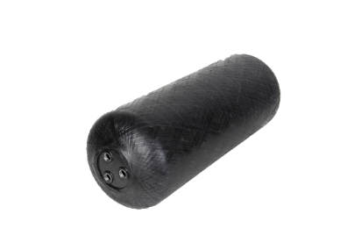

Why OTOM?
What are Benefits?
Simulation CAE tool (Ray-tracing + FEM ) to predict and manage processing
Providing guideline for manufacturing decisions and design
Shorten trial-and-error loops & lead times
Identify best process parameters for product quality
Process Design
Software solution
Process Manufacturing
Product
Courtesy of Fraunhofer IPT

Slide 7

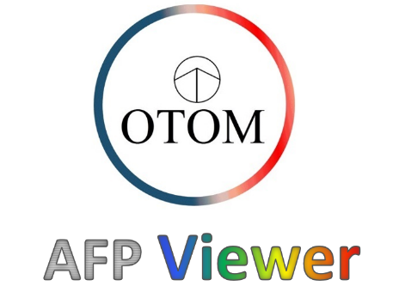
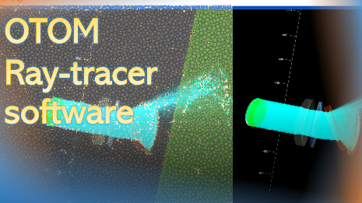
products
AFP Viewer:
Post-processing software for AFP process
Ray-tracer:
General Ray-tracing software for energy absorption, transmittance in and through materials
AFP Engine:
Process Simulation for AFP process, predicting temperature, crystallinity

Slide 8
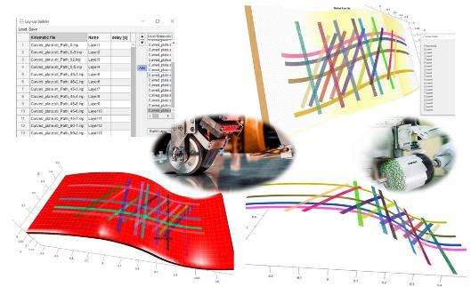
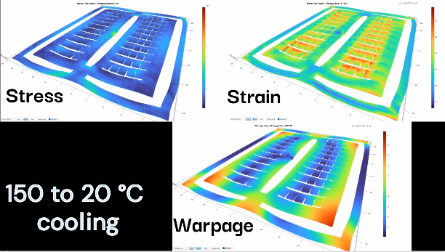
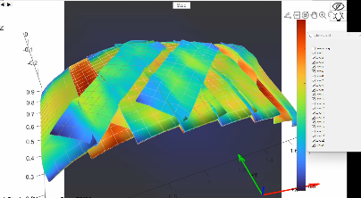
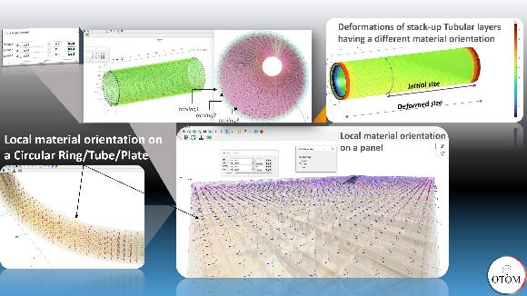
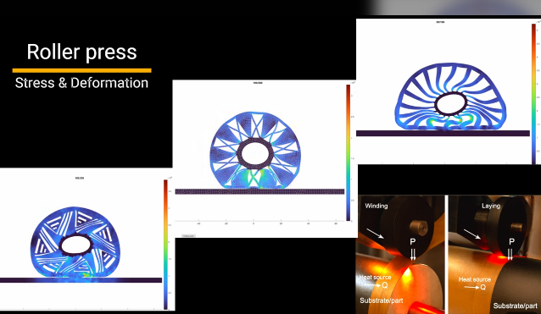
AFP Engine:
Layup build
Accurate Lay-up build for automatic contact and Boundary condition generation
Mesh creation for thermal and optical analysis
Design tool: Quick Elastoplastic analysis of the layers, ply-to-ply composite simulation

Slide 9
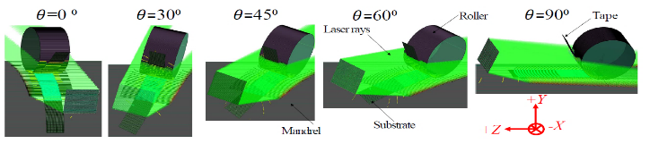
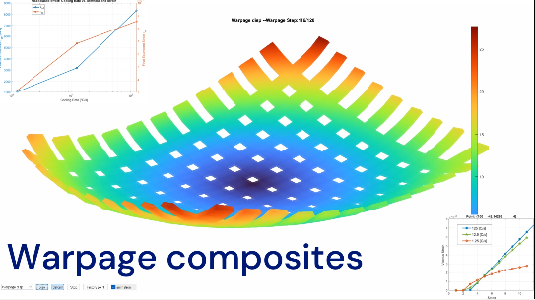
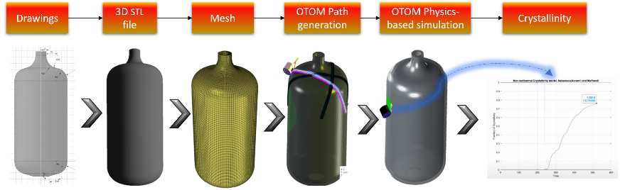
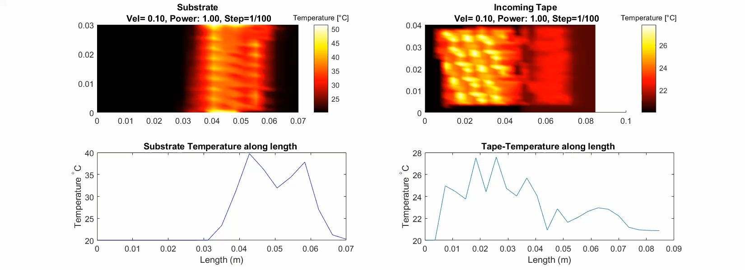
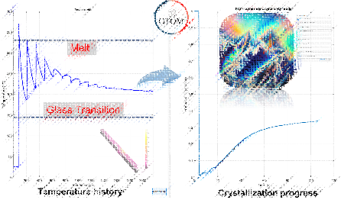
AFP Engine:
Thermo-optical modeling
Quantify temperature variation for placement angle changes, velocity-induced variation, etc.
Adjust process parameters like power by the optimization tool

Slide 10
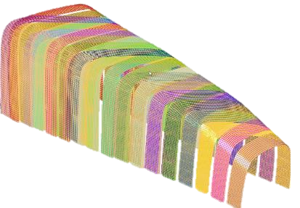
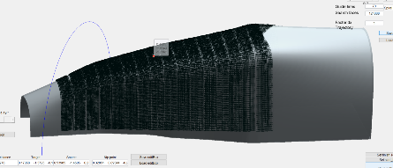
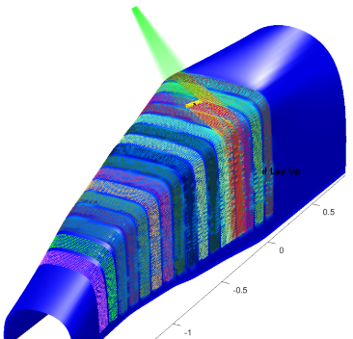
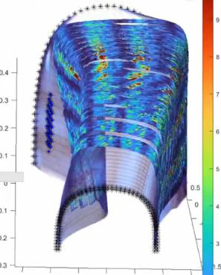
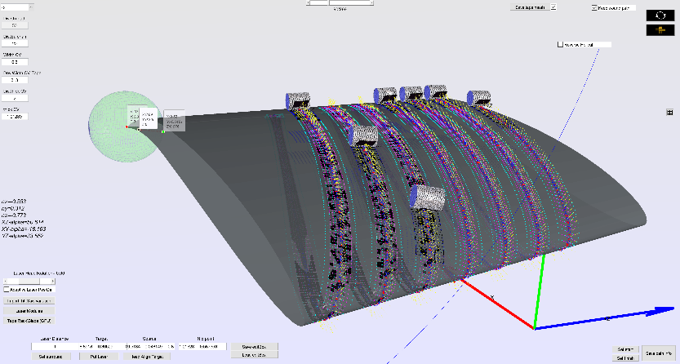
AFP Engine:
Thermal history and crystallinity prediction on complex layups:
F1 car Body nose showcase
Layup design
Layup generation
Ray-tracing and thermal simulations
Deformation
1- Layup 29 layers on the F1 Nose mold
2- Perform Optical-thermal simulations
3- Observe the predicted temperature at every layer through the processing time

Slide 11
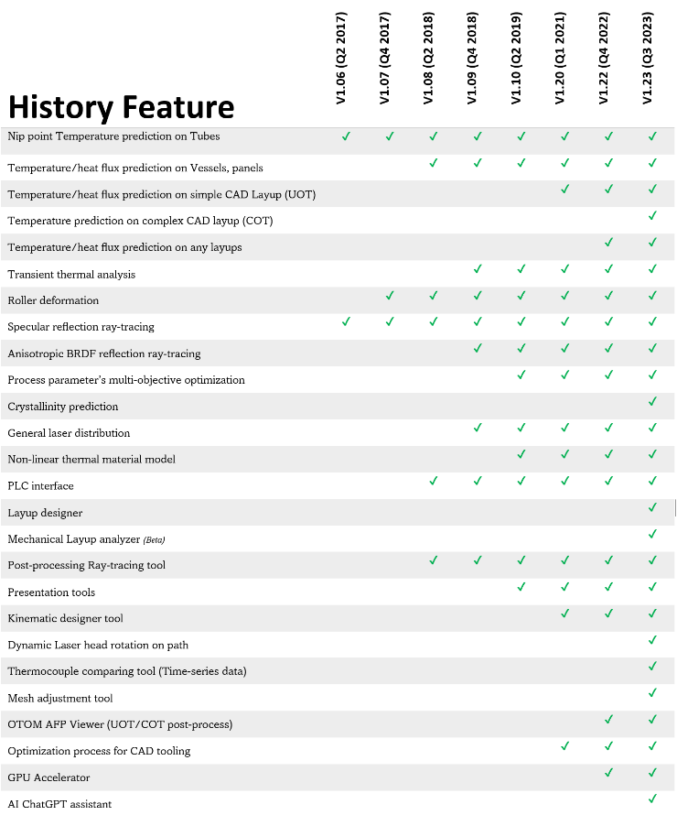
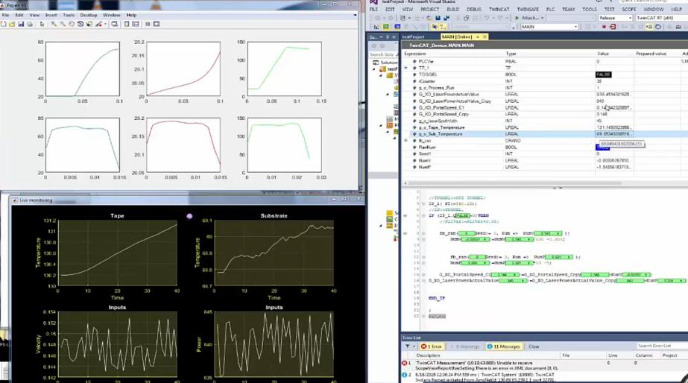
Inline Monitoring
OTOM is not only the simulation software, but also a tool to interact with the PLC such as Beckhoff PLC, Siemens PLC, etc.
1- Fast Inline monitoring algorithm (~1 millisecond response)
2- Real large process data from experiments as offline (~400K set of data)
https://www.otomcomposite.eu/inline-monitoring/
Notes:
Give Temperature output every ~5 millisecond
To go more details..
We are working on this

Slide 12
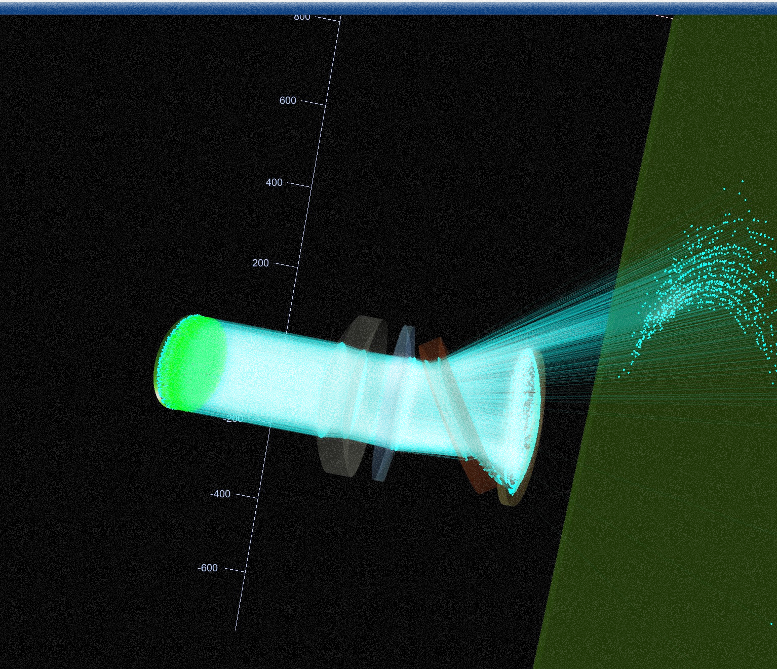
OTOM Ray-tracer:
The OTOM 𝐑𝐚𝐲-𝐓𝐫𝐚𝐜𝐢𝐧𝐠 tool is a complementary software, providing a sophisticated platform for conducting high-fidelity ray-tracing analyses on both 𝐨𝐩𝐚𝐪𝐮𝐞 𝐚𝐧𝐝 𝐭𝐫𝐚𝐧𝐬𝐩𝐚𝐫𝐞𝐧𝐭 objects.
This tool excels in precisely determining ray intersection points and accurately assessing the 𝐞𝐧𝐞𝐫𝐠𝐲 𝐭𝐫𝐚𝐧𝐬𝐟𝐞𝐫 within optical systems and objects.

Slide 13
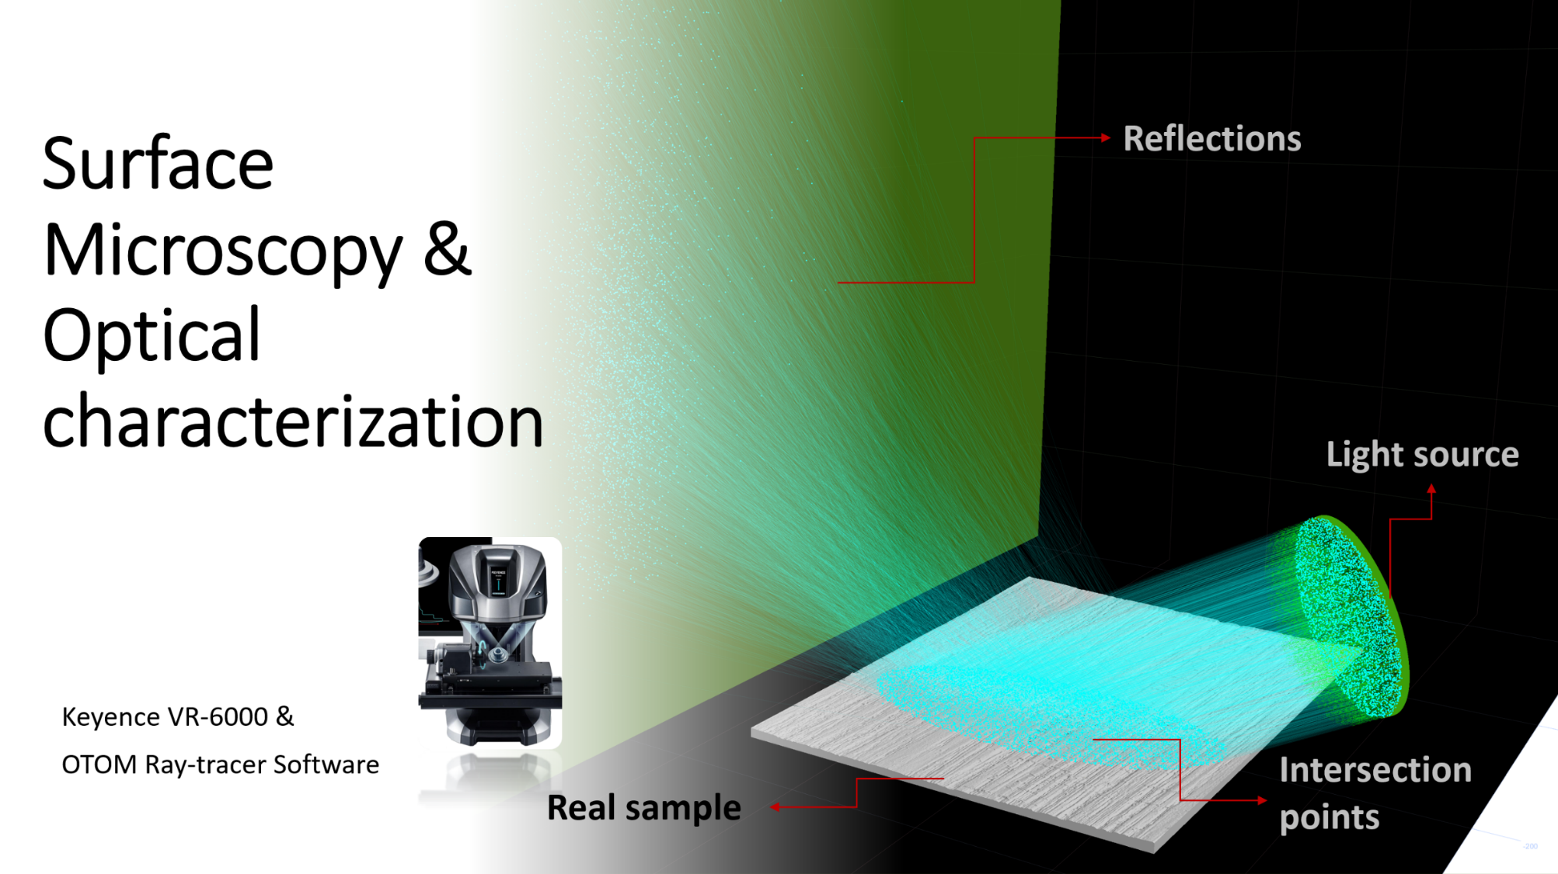
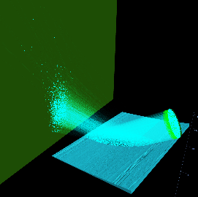
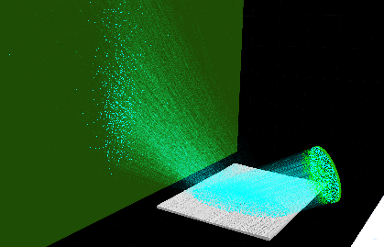
PA6-GF
HDPE-GF

Slide 14
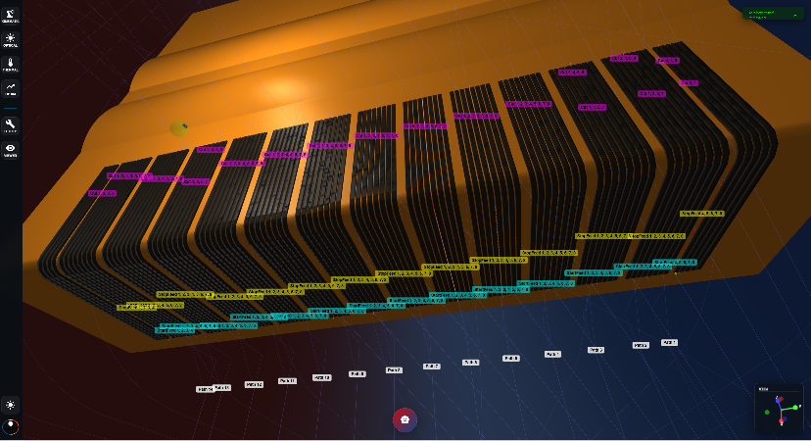
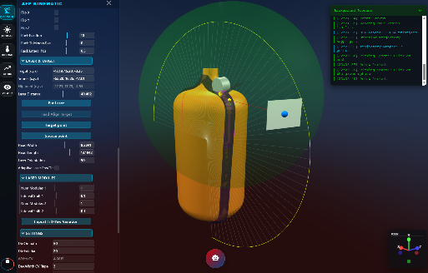
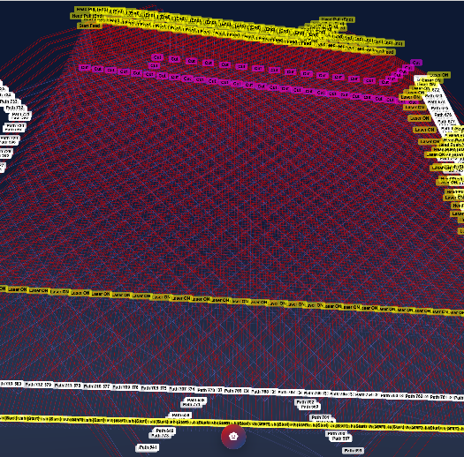
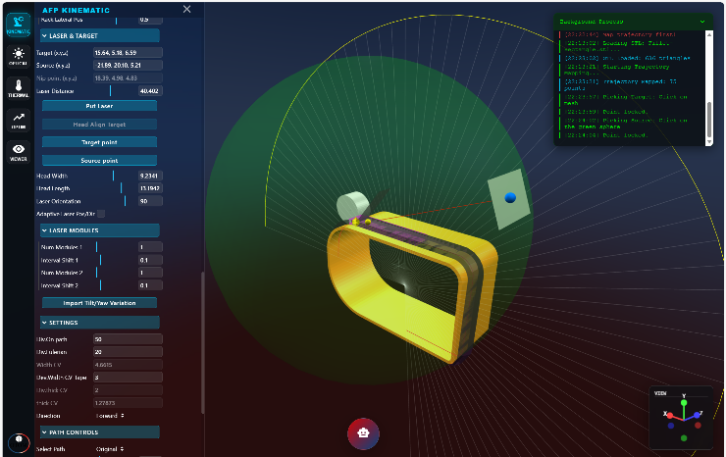
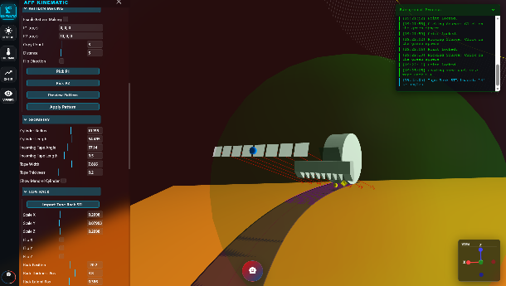
AFP Web platform
Automated fiber placement process simulation software

Slide 15
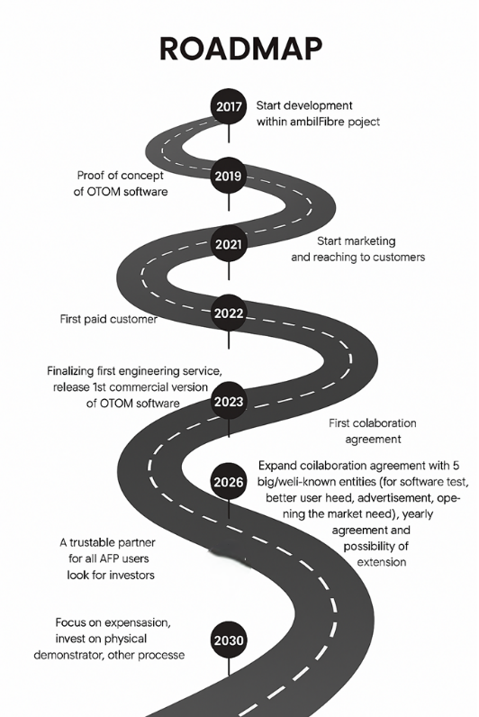

Composite partners
Customer/ USEr

Slide 16
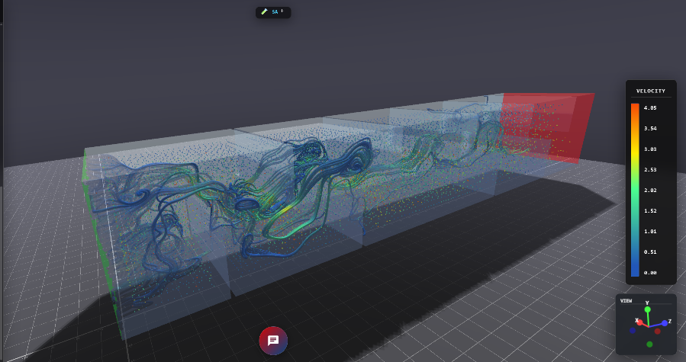
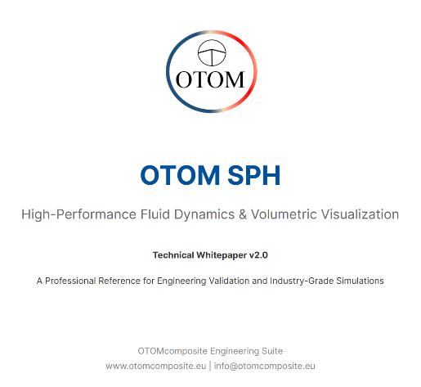
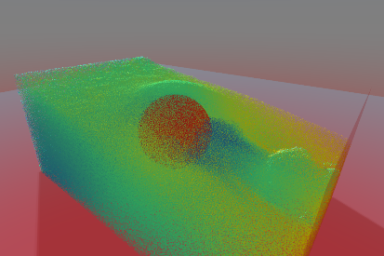
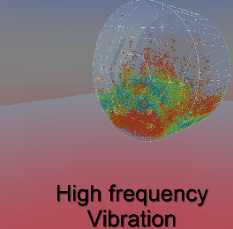
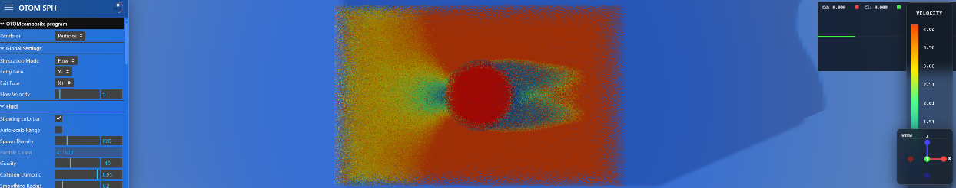
OTOM SPH
Real-time GPU-accelerated CFD (Custom-made)
**Fluid Simulation**: Model and visualize fluid dynamics using the Weakly Compressible SPH algorithm for realistic behaviors.
**Turbulence Modeling**: Implement SPS-LES turbulence and vorticity confinement for enhanced detail in fluid motion.
**Real-time Calculations**: Calculate drag (Cd) and lift (Cl) in real-time using impulse or pressure methods for performance analysis.
**Advanced Rendering**: Utilize Marching Cubes, Volumetric Raymarching, and Screen Space Fluid Rendering for high-quality visual outputs.
**Custom Parameters**: Adjust flow velocity, vibration, and other parameters to simulate different environmental conditions and study their effects on fluid behavior.
Flow in heat exchanger
3D Container
Lift/ drag of standard Sphere

Slide 17
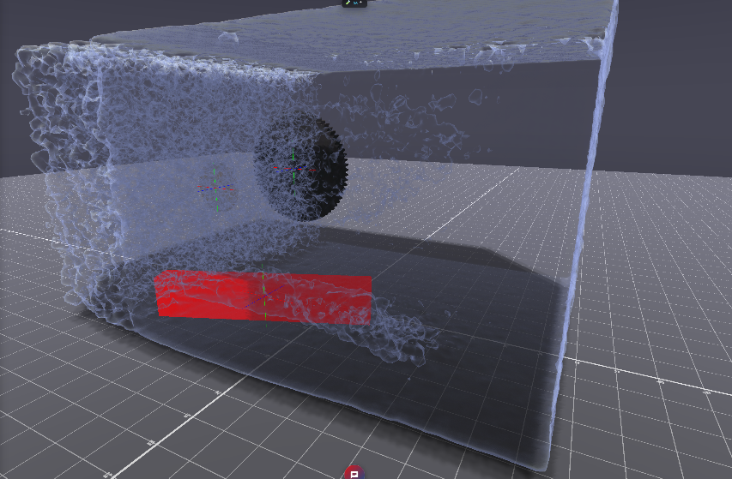
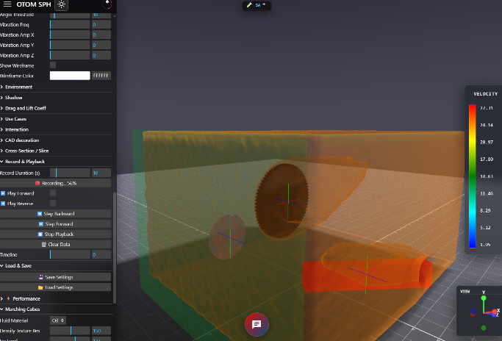
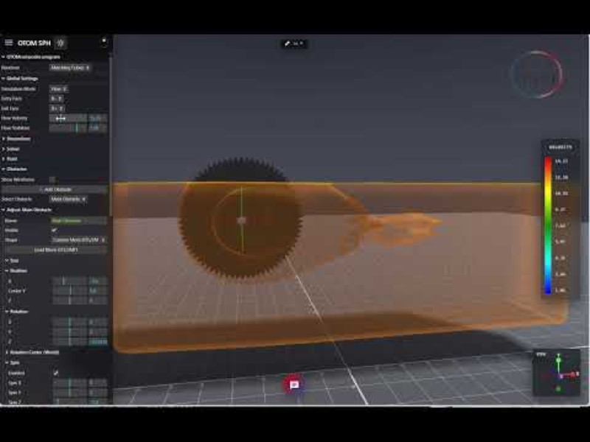
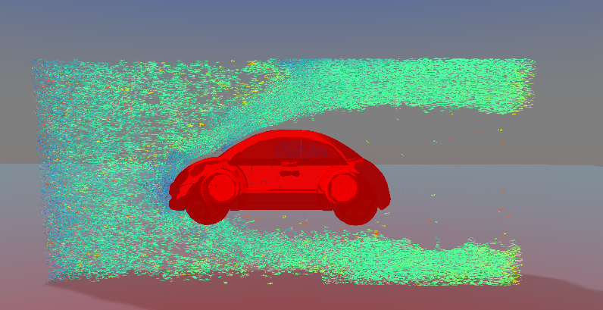
Realistic Digital Twin

Slide 18
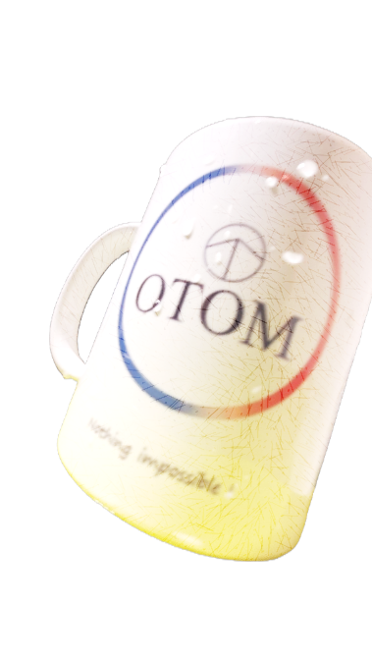

What we offer?
Custom-made software
Software license subscription
Engineering service
➔ It Usually starts with a Pilot project

Slide 19




Thanks for reaching out here
2020
2026
Email:
info@otomcomposite.eu
Phone: +31-6 19 32 12 99
Social media page:
https://www.linkedin.com/company/otomcomposite
Youtube:
https://www.youtube.com/channel/UC0hZch31FHza6vO3sg2RJmg
Website:
https://otomcomposite.eu

